Slide 1
Poverty and Food Insecurity rates in the United States
Story 6
Alex Khaykin

Slide 2
INTRODUCTION
US households experiencing food insecurity and SNAP benefit participation from 2001 to 2022. The data shows that the percentage of food-insecure households has increased over time, with a sharp increase in 2022. Further, SNAP benefit participation has increased over time, with a slight decrease in 2022. Overall, the plot suggests that food insecurity is a growing problem in the US that requires attention and action.

Slide 3
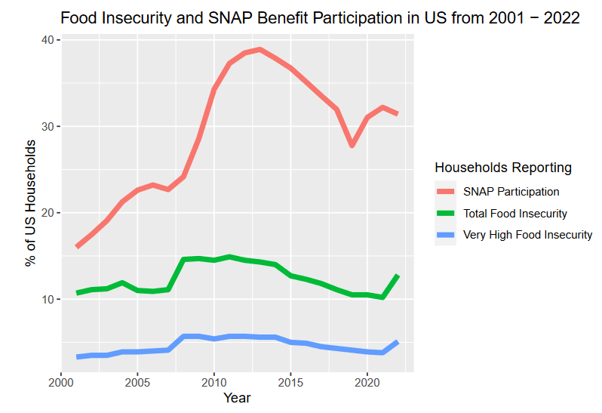
The percentage of food-insecure households has increased over time, with a sharp increase in 2022.

Slide 4
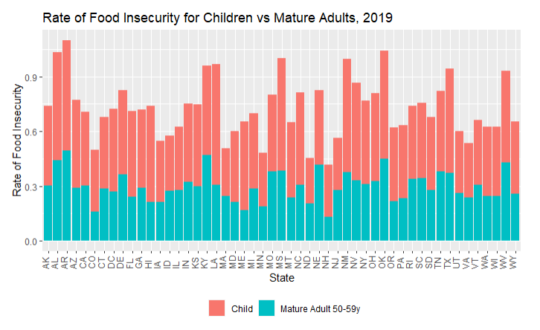
The bar plot shows the rate of food insecurity for children and mature adults (50-59 years old) in each state in 2019.

Slide 5
CONCLUSION
According to the United States Department of Agriculture (USDA) Economic Research Service (ERS), 12.8% of US households were food insecure at least some time during the year 2022, meaning they had difficulty providing enough food for all their members because of a lack of resources. Poverty in childhood also has been linked to serious, long-term economic consequences, including higher health care expenditures, lower educational achievement, lost productivity and lower earnings in adulthood, and increased risk of poverty later in life.

Slide 6
Sources
https://www.ers.usda.gov/topics/food-nutrition-assistance/food-security-in-the-u-s/key-statistics-graphics/#map
https://www.fns.usda.gov/pd/supplemental-nutrition-assistance-program-snap
https://fred.stlouisfed.org/series/TTLHH

